Slide 1
CSC373
Week 3

Slide 2
Huffman Code
Variable
Length encoding
Better approach because every letter has a different frequency of occurrence

Slide 3
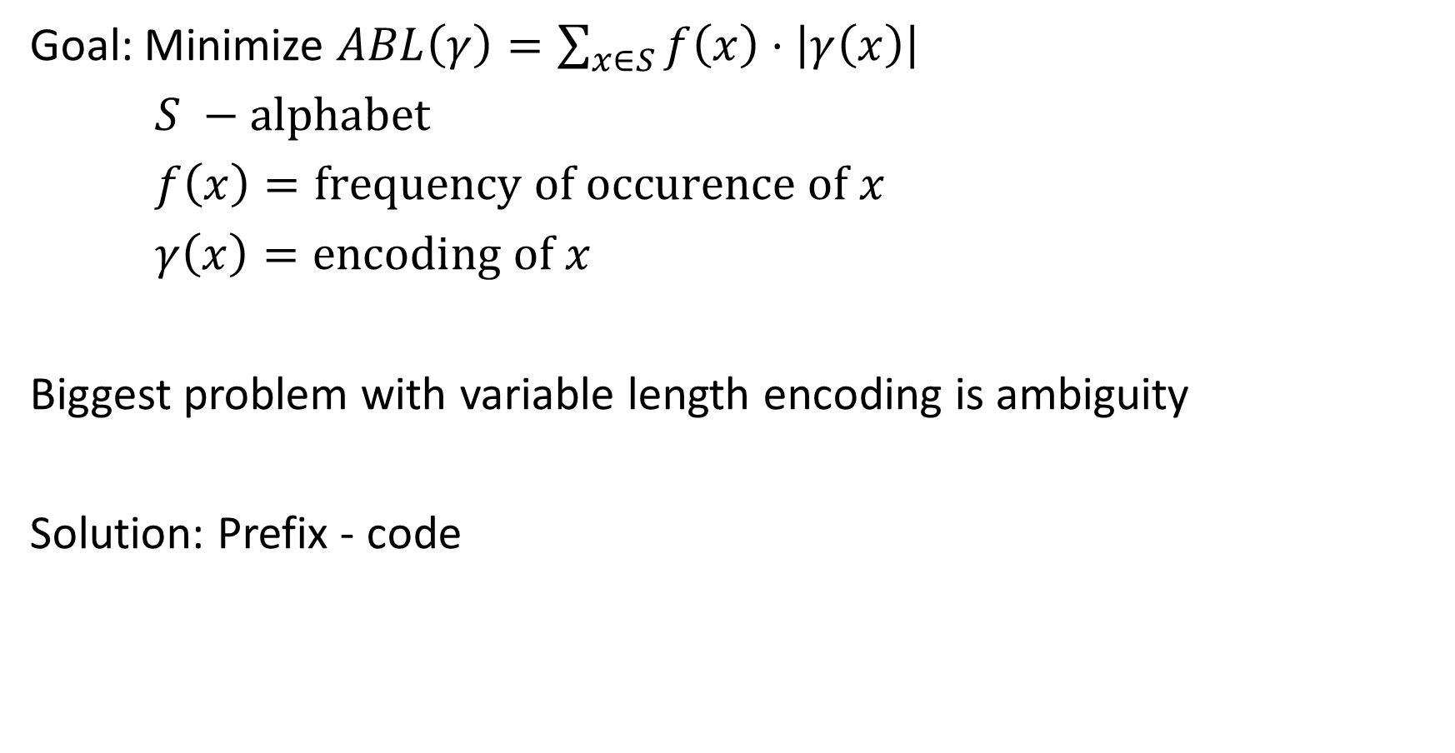
Goal: Minimize $ABL\left(γ\right)=\sum_{x∈S}{f\left(x\right)⋅\left|γ\left(x\right)\right|}$
$S −\text{alphabet}$
$f\left(x\right)=\text{frequency} \text{of} \text{occurence} \text{of} x$
$γ\left(x\right)=\text{encoding} \text{of} x$
Biggest problem with variable length encoding is ambiguity
Solution: Prefix - code

Slide 4







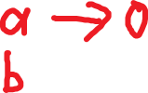


How to generate prefix codes?
Prefix-Code $↔$ Full binary tree

Slide 5
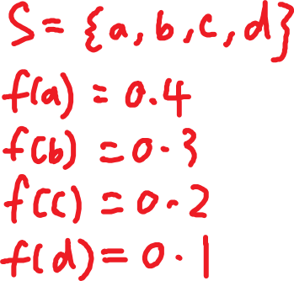










Notes

Slide 6
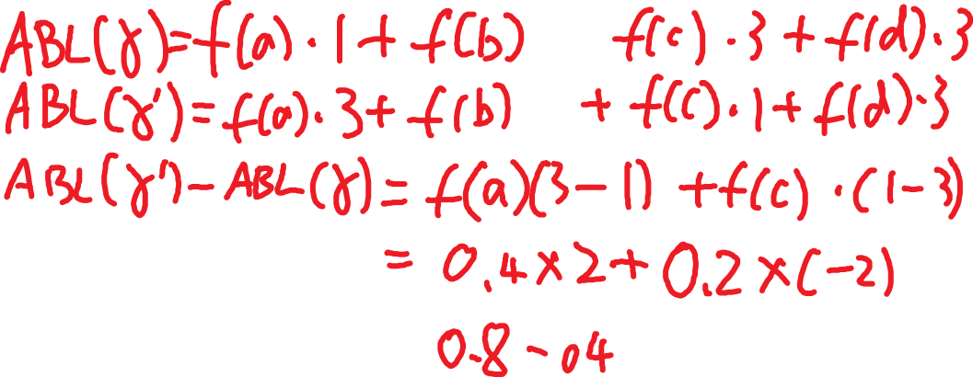



Notes

Slide 7
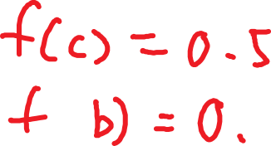
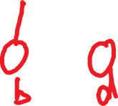




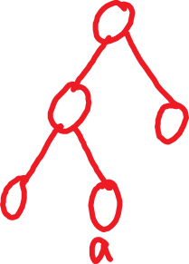





Slide 8

Claim: Let $x$ and $y$ be the two least frequent letters. Then there is same optimal tree where $x$ and $y$ are siblings.

Slide 9
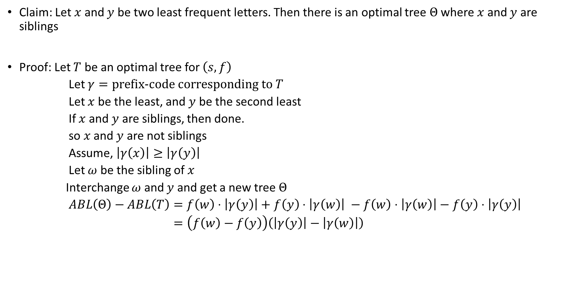
Claim: Let $x$ and $y$ be two least frequent letters. Then there is an optimal tree $Θ$ where $x$ and $y$ are siblings
Proof: Let $T$ be an optimal tree for $\left(s, f\right)$
Let $γ=\text{prefix}\text{-}\text{code} \text{corresponding} \text{to} T$
Let $x$ be the least, and $y$ be the second least
If $x$ and $y$ are siblings, then done.
so $x$ and $y$ are not siblings
Assume, $\left|γ\left(x\right)\right|≥\left|γ\left(y\right)\right|$
Let $ω$ be the sibling of $x$
Interchange $ω$ and $y$ and get a new tree $Θ$
$ABL\left(Θ\right)−ABL\left(T\right)=f\left(w\right)⋅\left|γ\left(y\right)\right|+$ $f\left(y\right)⋅\left|γ\left(w\right)\right| −f\left(w\right)⋅\left|γ\left(w\right)\right|−f\left(y\right)⋅\left|γ\left(y\right)\right|$
$=\left(f\left(w\right)−f\left(y\right)\right)\left(\left|γ\left(y\right)\right|−\left|γ\left(w\right)\right|\right)$

Slide 10



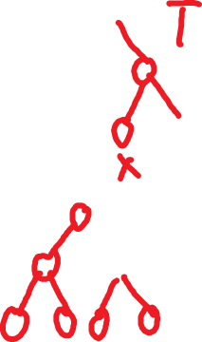


Notes

Slide 11

Proof (continued)
So, $\left|γ\left(y\right)\right|−\left|γ\left(w\right)\right|=\left|γ\left(y\right)\right|−\left|γ\left(x\right)\right|≤0$
So, $ABL\left(Θ\right)−ABL\left(T\right)≤0$
Since $T$ is optimal, $ABL\left(Θ\right)−ABL\left(T\right)≮0$
$⇒ABL\left(Θ\right)−ABL\left(T\right)=0$
$⇒ABL\left(Θ\right)=ABL\left(T\right)$
$⇒Θ \text{is} \text{optimal}$

Slide 12
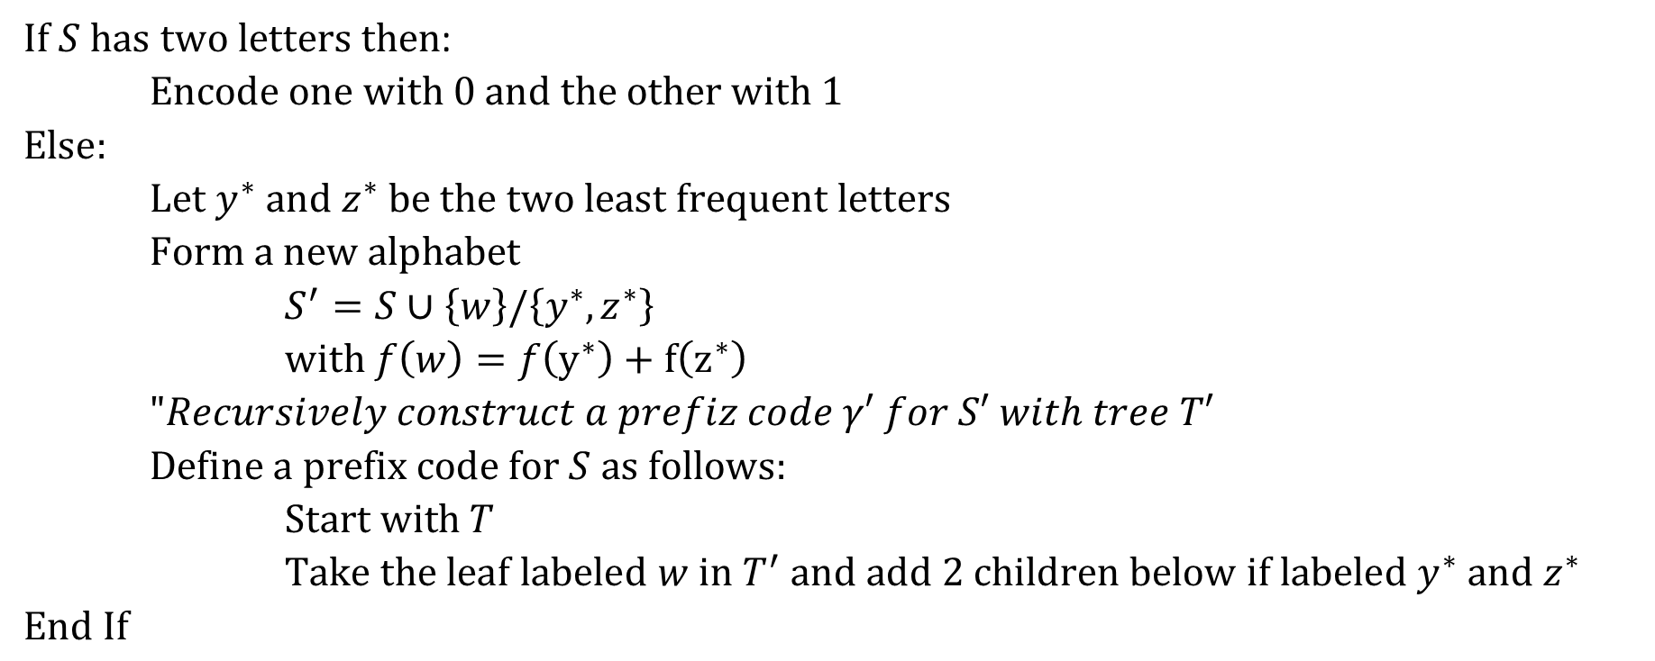
Huffman Coding
$\text{If} S \text{has} \text{two} \text{letters} \text{then}$:
$\text{Encode} \text{one} \text{with}\text{ 0 }\text{and} \text{the} \text{other} \text{with}\text{ 1}$
$\text{Else}:$
$\text{Let} y^{∗} \text{and} z^{∗} \text{be} \text{the} \text{two} \text{least} \text{frequent} \text{letters}$
$\text{Form} \text{a} \text{new} \text{alphabet}$
$S^{′}=S∪\left\{w\right\}/\left\{y^{∗}, z^{∗}\right\}$
$\text{with} f\left(w\right)=f\left(y^{∗}\right)+f\left(z^{∗}\right)$
$"Recursively construct a prefiz code γ′ for S′ with tree T′$
$\text{Define} \text{a} \text{prefix} \text{code} \text{for} S \text{as} \text{follows}:$
$\text{Start} \text{with} T$
$\text{Take} \text{the} \text{leaf} \text{labeled} w \text{in} T^{′} \text{and} \text{add}\text{ 2 }\text{children} \text{below} \text{if} \text{labeled}$ $y^{∗} \text{and} z^{∗}$
$\text{End} \text{If}$

Slide 13
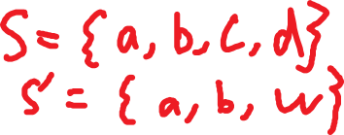
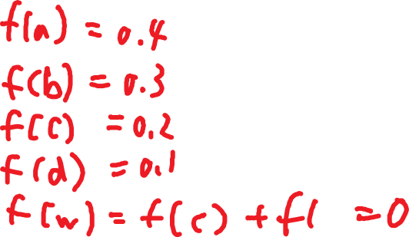
Notes

Slide 14
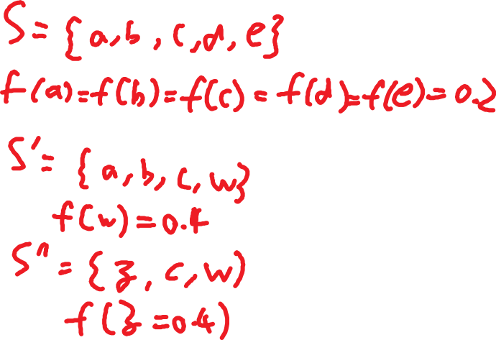
Notes

Slide 15
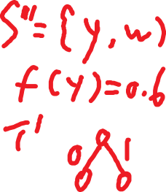
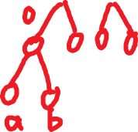
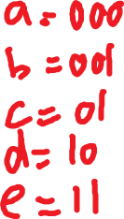
Notes

Slide 16
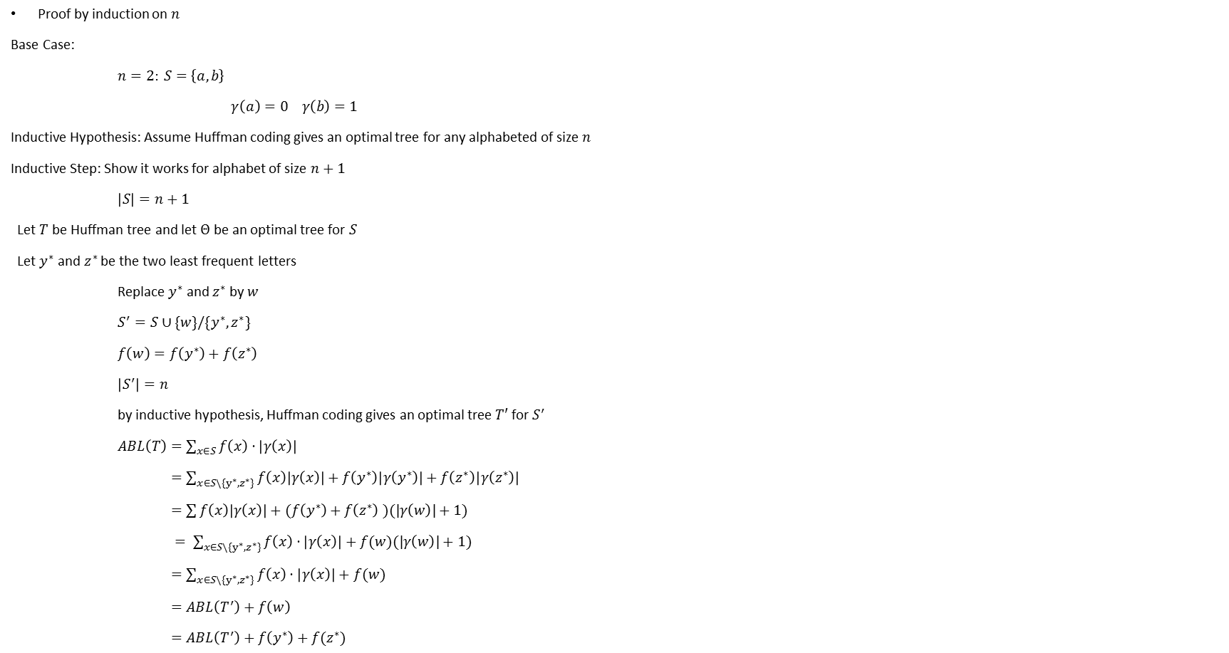
Proof why Huffman Coding works
Proof by induction on $n$
Base Case:
$n=2:$ $S=\left\{a, b\right\}$
$γ\left(a\right)=0 γ\left(b\right)=1$
Inductive Hypothesis: Assume Huffman coding gives an optimal tree for any alphabeted of size $n$
Inductive Step: Show it works for alphabet of size $n+1$
$\left|S\right|=n+1$
Let $T$ be Huffman tree and let $Θ$ be an optimal tree for $S$
Let $y^{∗}$ and $z^{∗}$ be the two least frequent letters
Replace $y^{∗}$ and $z^{∗}$ by $w$
$S^{′}=S∪\{w\}/\{y^{∗}, z^{∗}\}$
$f\left(w\right)=f\left(y^{∗}\right)+f\left(z^{∗}\right)$
$\left|S^{′}\right|=n$
by inductive hypothesis, Huffman coding gives an optimal tree $T′$ for $S^{′}$
$ABL\left(T\right)=\sum_{x∈S}{f\left(x\right)⋅\left|γ\left(x\right)\right|}$
$=\sum_{x∈S\backslash \{y^{∗},z^{∗}\}}{f\left(x\right)\left|γ\left(x\right)\right|}+f\left(y^{∗}\right)\left|γ\left(y^{∗}\right)\right|+f\left(z^{∗}\right)\left|γ\left(z^{∗}\right)\right|$
$=\sum{f\left(x\right)\left|γ\left(x\right)\right|+(f\left(y^{∗}\right)+f\left(z^{∗}\right)}$ $)(|γ\left(w\right)|+1)$
$= \sum_{x∈S\backslash \{y^{∗},z^{∗}\}}{f\left(x\right)⋅\left|γ\left(x\right)\right|+f(w)(|γ\left(w\right)|+1)}$
$=\sum_{x∈S\backslash \{y^{∗},z^{∗}\}}{f\left(x\right)⋅\left|γ\left(x\right)\right|+f(w)}$
$=ABL\left(T^{′}\right)+f\left(w\right)$
$=ABL\left(T^{′}\right)+f\left(y^{∗}\right)+f(z^{∗})$

Slide 17


Proof (continued)
Assume for a contradiction that $T$ is not optimal
Let $Ο$ be an optimal tree for $S$ such that $y^{∗}$ and $z^{∗}$ are sibling in $Ο$ (by claim proved before)
If you remove $y^{∗}$ and $z^{∗}$ from $Ο$ and replace them by $w$ with $f\left(w\right)=f\left(y^{∗}\right)+f(z^{∗})$
Then this new tree $Ο′$ must be optimal for $S^{′}$
So $ABL\left(Ο^{′}\right)=ABL\left(T^{′}\right)$
$⇒ABL\left(Ο^{′}\right)+f\left(y^{∗}\right)+f\left(z^{∗}\right)=ABL\left(T^{′}\right)+f\left(y^{∗}\right)+f\left(z^{∗}\right)=ABL\left(T\right)$

Slide 18
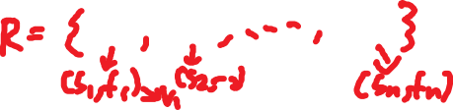




Weighted Interval Scheduling
Single Resource
Input
Goal: Maximize the total value of jobs scheduled

Slide 19


Use Greedy

Slide 20



Use Greedy (continued)

Slide 21
III. Dynamic Programming
Decompose a problem into several subproblems and combine solutions

Slide 22
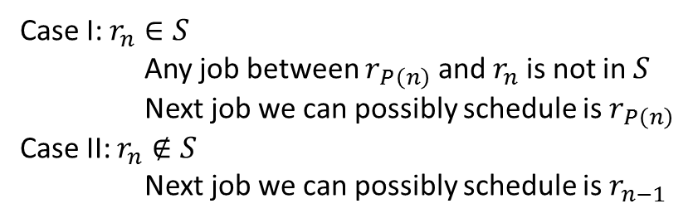
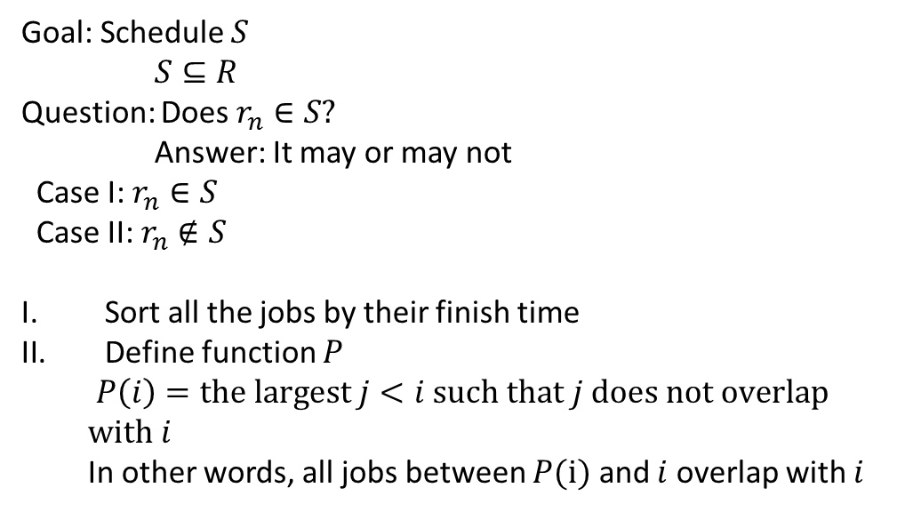
Goal: Schedule $S$
$S⊆R$
Question: Does $r_{n}∈S?$
Answer: It may or may not
Case I: $r_{n}∈S$
Case II: $r_{n}∉S$
Sort all the jobs by their finish time
Define function $P$
$P\left(i\right)=\text{the} \text{largest} j<i \text{such} \text{that} j \text{does} \text{not} \text{overlap} \text{with} i$
In other words, all jobs between $P(i)$ and $i$ overlap with $i$
Case I: $r_{n}∈S$
Any job between $r_{P\left(n\right)}$ and $r_{n}$ is not in $S$
Next job we can possibly schedule is $r_{P\left(n\right)}$
Case II: $r_{n}∉S$
Next job we can possibly schedule is $r_{n−1}$

Slide 23
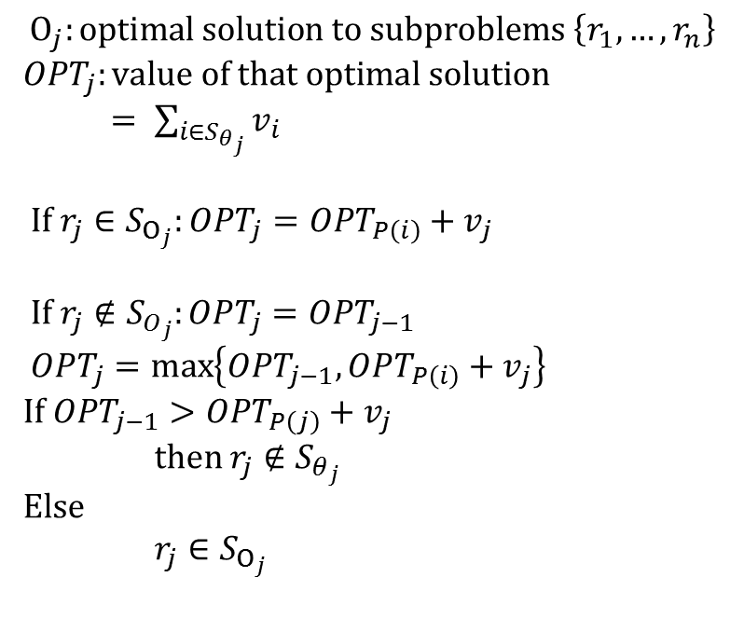
Subproblems look like solve the same problem on $\left\{r_{1},…,r_{j}\right\}$
$1≤j≤n$
$$Ο_{j}:\text{optimal} \text{solution} \text{to} \text{subproblems} \left\{r_{1},…,r_{n}\right\}$$
$OPT_{j}:\text{value} \text{of} \text{that} \text{optimal} \text{solution}$
$= \sum_{i∈S_{θ_{j}}}{v_{i}}$
$If r_{j}∈S_{Ο_{j}}:OPT_{j}=OPT_{P\left(i\right)}+v_{j}$
$\text{If} r_{j}∉S_{O_{j}}:OPT_{j}=OPT_{j−1}$
$OPT_{j}=\max\left\{OPT_{j−1}, OPT_{P\left(i\right)}+v_{j}\right\}$
$\text{If} OPT_{j−1}>OPT_{P\left(j\right)}+v_{j}$
$\text{then} r_{j}∉S_{θ_{j}}$
$\text{Else}$
$r_{j}∈S_{Ο_{j}}$

Slide 24
Compute_WIS(i, P)
if j == 0:
return 0
Else
s1 = Compute_WIS((P(i), P) + v_j
s2 = Compute_WIS(j-1, P)
return max(S_1, S_2)

Slide 25



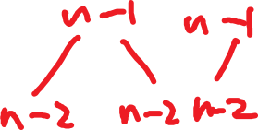






Complexity: $Ο\left(2^{n}\right)$

Slide 26
Solution: Save the results of any computation of use that as a cache
compute_WIS(j, P, M)
if M[j] is defined
return M[j]
else:
if j == 0 then
q = 0
else
q = max(S_1, S_2)
(S_1, S_2 as before)
M[j] = q
return q

